Slide 1
Workers Compensation
Claim Reporting, Investigation and
Follow Up

Slide 2
What We’re Going to Cover
Teach you the proper way to investigate and report work related injuries.
Provide links, information and resource materials for Workers’ Compensation accident reporting.
Answer questions you may have regarding the reporting of work injuries.
Show you how to complete the ISTAR report.

Slide 3
Workers Compensation Forms
DWC1 – Workers’ Compensation Claim Form
MAF – Medical Authorization Form
Doctor List – Medical Panel
ISTAR – Incident System Tracking Accountability Report
Claim Withdrawal Form
Note: Form can also be found on the FSD website, in the HR forms section.

Slide 4
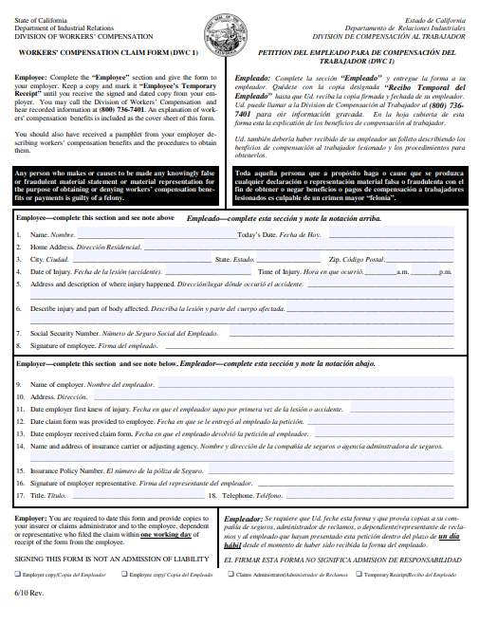
Workers Compensation Claim Forms
DWC1 – Workers’ Compensation Claim Form
DWC1 form is given to the employee when an injury occurs on the job.

Slide 5
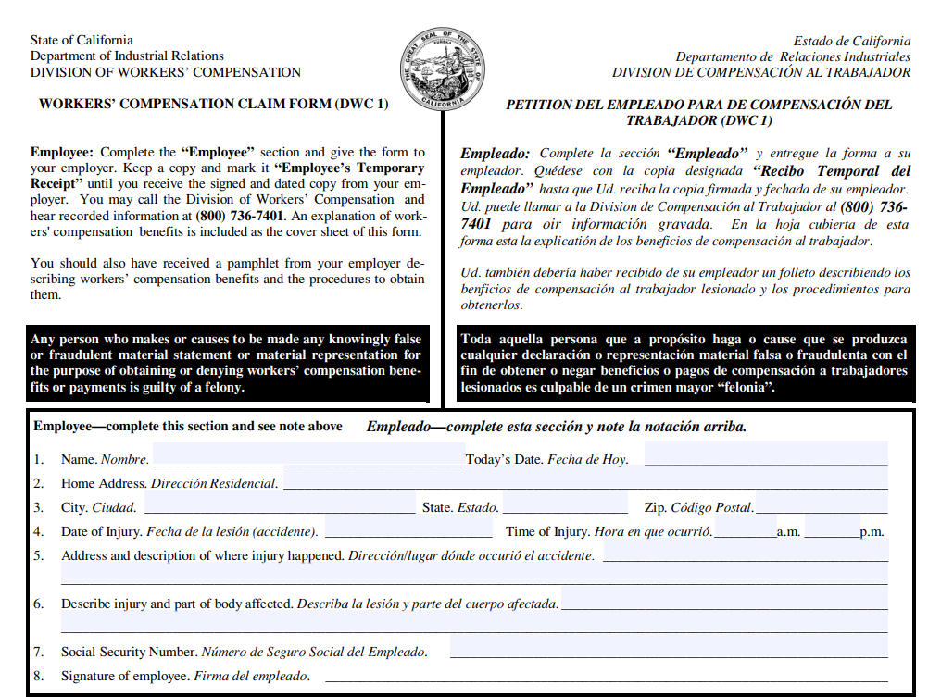
Workers Compensation Claim Forms
DWC1 – Workers’ Compensation Claim Form
DWC1 form is given to the employee when an injury occurs on the job.

Slide 6
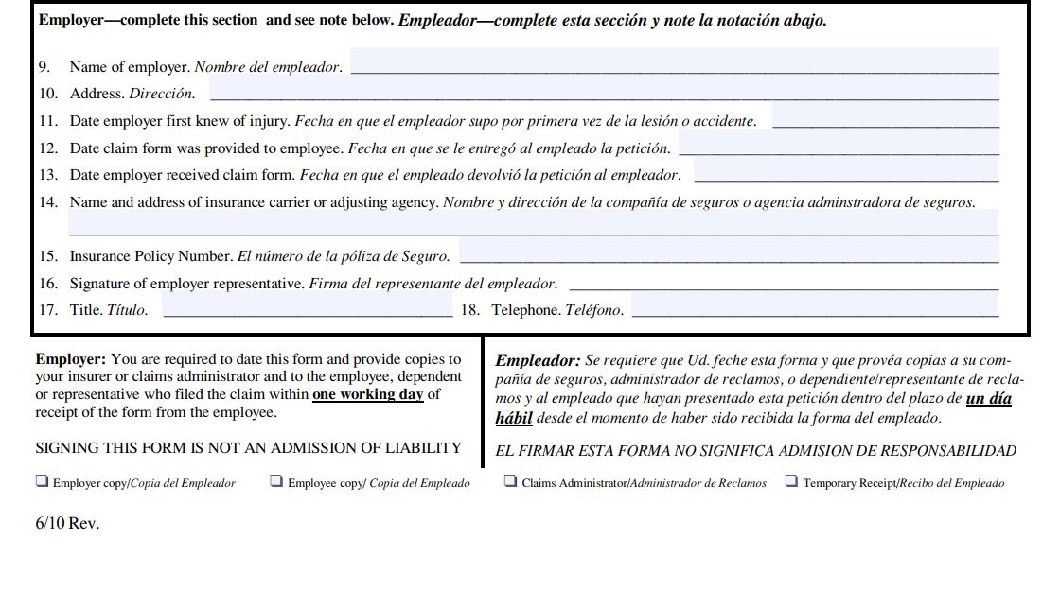
Workers Compensation Claim Forms
DWC1 – Workers’ Compensation Claim Form
DWC1 form is given to the employee when an injury occurs on the job.
Sedgwick
Self-Insured

Slide 7
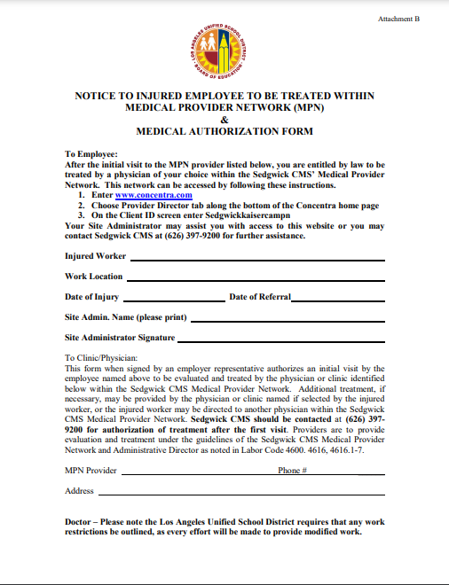
Medical Authorization Form
The employee must take this form with them to the Doctor.
Keep several copies on hand after the after the employee has selected a doctor from the MPN list.

Slide 8
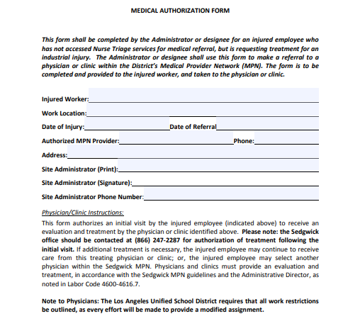

Slide 9
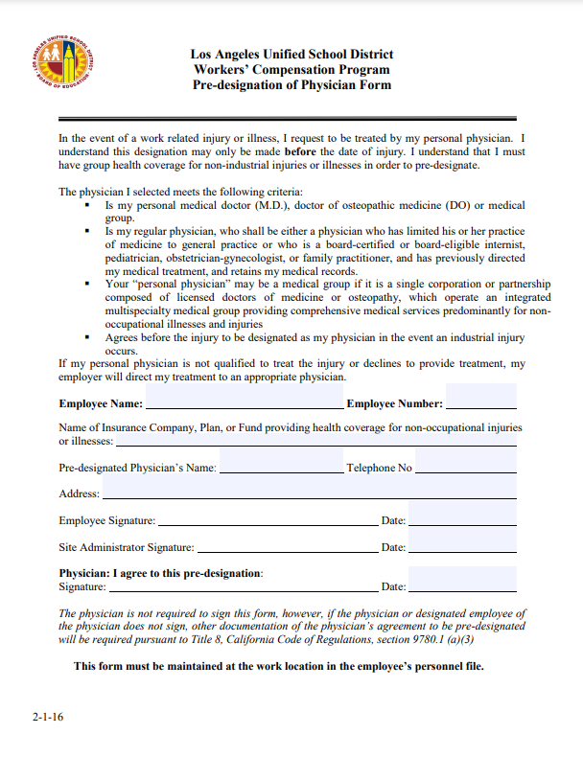
Pre-designation of
Physician Form
The form stays on file in the managers office.

Slide 10
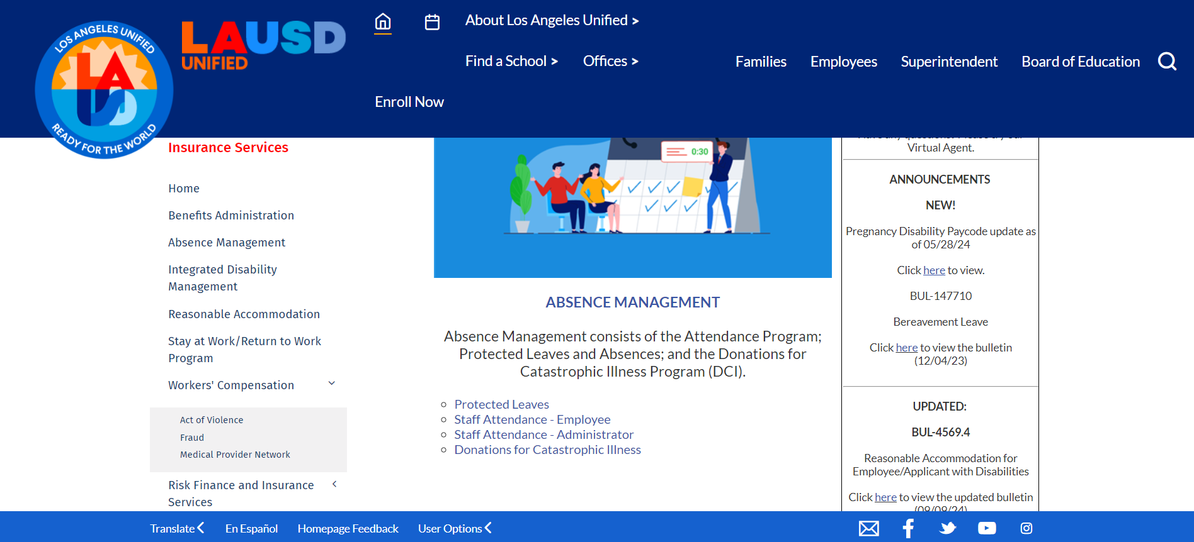
Choosing Medical Provider from Network
In emergency medical situations, if emergency medical care is required:
Immediately call 911.
In non-emergency medical situations:
The referral panel is available at http://disabilitymanagement.lausd.net under Workers’ Compensation (click on Medical Provider Network).

Slide 11
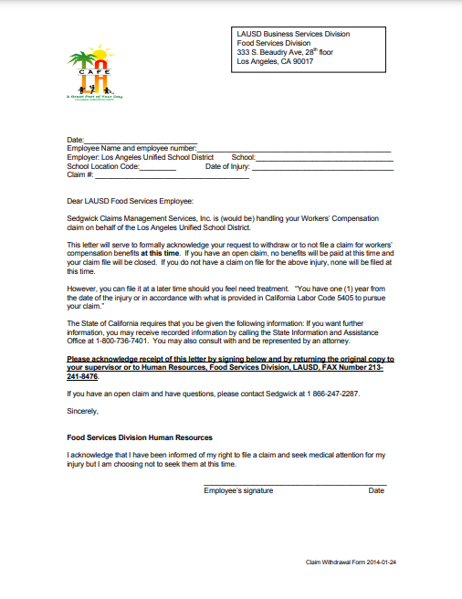
Medical Withdrawal
Form
This letter serves as acknowledgement that the employee wishes to withdrawal or to not file a claim of Worker’s Compensation benefits.
The employee has one (1) year from the date of injury to file a claim as provided by California Labor Code 5405.

Slide 12
Workers Compensation Summary
If the employee’s injury only requires first aid, send employee to nurse. If an emergency call 911 immediately.
DWC-1 Form: complete the Employer portion and have the employee complete the employee portion if they are able. If they are not able, complete the employer portion and put the form in the mail to the employee. *(This should be previously done and on file in the cafeteria.)
As soon as possible – get a written statement from the employee and any witnesses. *(They must sign and date)
Medical Authorization Form should be completed for employee to take with them to the doctor. It should be on file in the office.
Pick a doctor from the Medical Panel list of Doctors. *(This should be done previously and on file in the cafeteria.)

Slide 13
Complete
Within 24 Hours
Call injury into Sedgwick (800) 528-7392 only if the employee is going to the doctor!
See Reference Guide 1279.2 Workers’ Compensation Claims Reporting.
If the employee is not going to the doctor – have him or her sign a Claim Withdrawal Form (see above). Do not generate a claim.
Complete the DWC-1 Form and the ISTAR report, covered after this session.
In the event the employee decides to file a claim, we must show we investigated the matter at the time the accident happened.
Regarding return to work: you should ensure employee brings doctor’s release in order to return to work. If the employee is off work for more than 5 days, employee must get a food handler’s certificate for food safety.

Slide 14
Complete
Within 24 Hours
Send FMLA paperwork to employee.
Employees must submit leave of absence paperwork if they are off 20 days or more and submit it to the Personnel Commission (PC).
If the injury was because of unsafe work practices, the FSM or AFSS must counsel the employee for the unsafe practice. Then, the manager must train them in the correct way to perform the task and document the training took place.
HR Reps | Email
Babatu Hansen – Central/East | babatu.hansen@lausd.net
Valerie Bell – South | valerie.bell@lausd.net
Regina Cooks – NE/NW | regina.cooks@lausd.net
Judith Garcia – Central/West | judith.garcia1@lausd.net

Slide 15
ISTAR

Slide 16
ISTAR:
Incident System Tracking Accountability Report
It is the District wide electronic reporting system designed to improve incident response operations for a wide variety of events.
It also provides a common framework in which staff from various divisions can work together effectively to provide standard response and assistance.

Slide 17
ISTAR:
Incident System Tracking Accountability Report
Today you will learn what is ISTAR and the purpose of this program.
At the end of this training, you will understand how to use this program.
The overall goal is to have all FSM’s accurately report incidents.
Note: ISTAR is not just for reporting incidents such as slips, falls, burns, cuts, ect.

Slide 18
ISTAR Objective
You will learn the following:
Required documents to be completed with ISTAR.
How to log into ISTAR.
How to complete the ISTAR report.
How to submit ISTAR report.

Slide 19
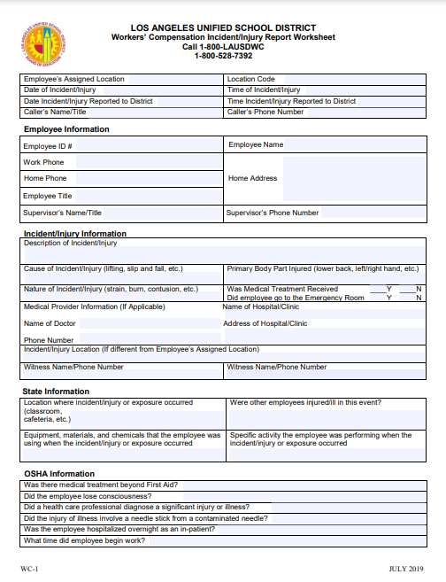
ISTAR:
Required Documents
Workers’ Compensation Injury Report Worksheet (WC-1)
This document must be completed within 24 hours.

Slide 20
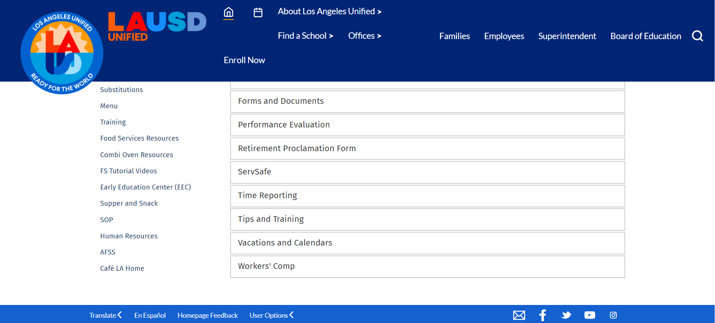
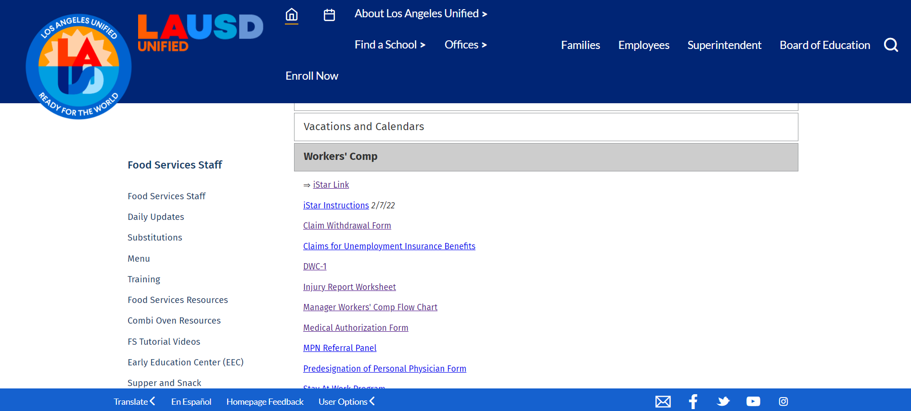
Finding ISTAR
FSD website > Human Resources > Workers’ Comp > ISTAR

Slide 21
Reporting ISTAR

Slide 22
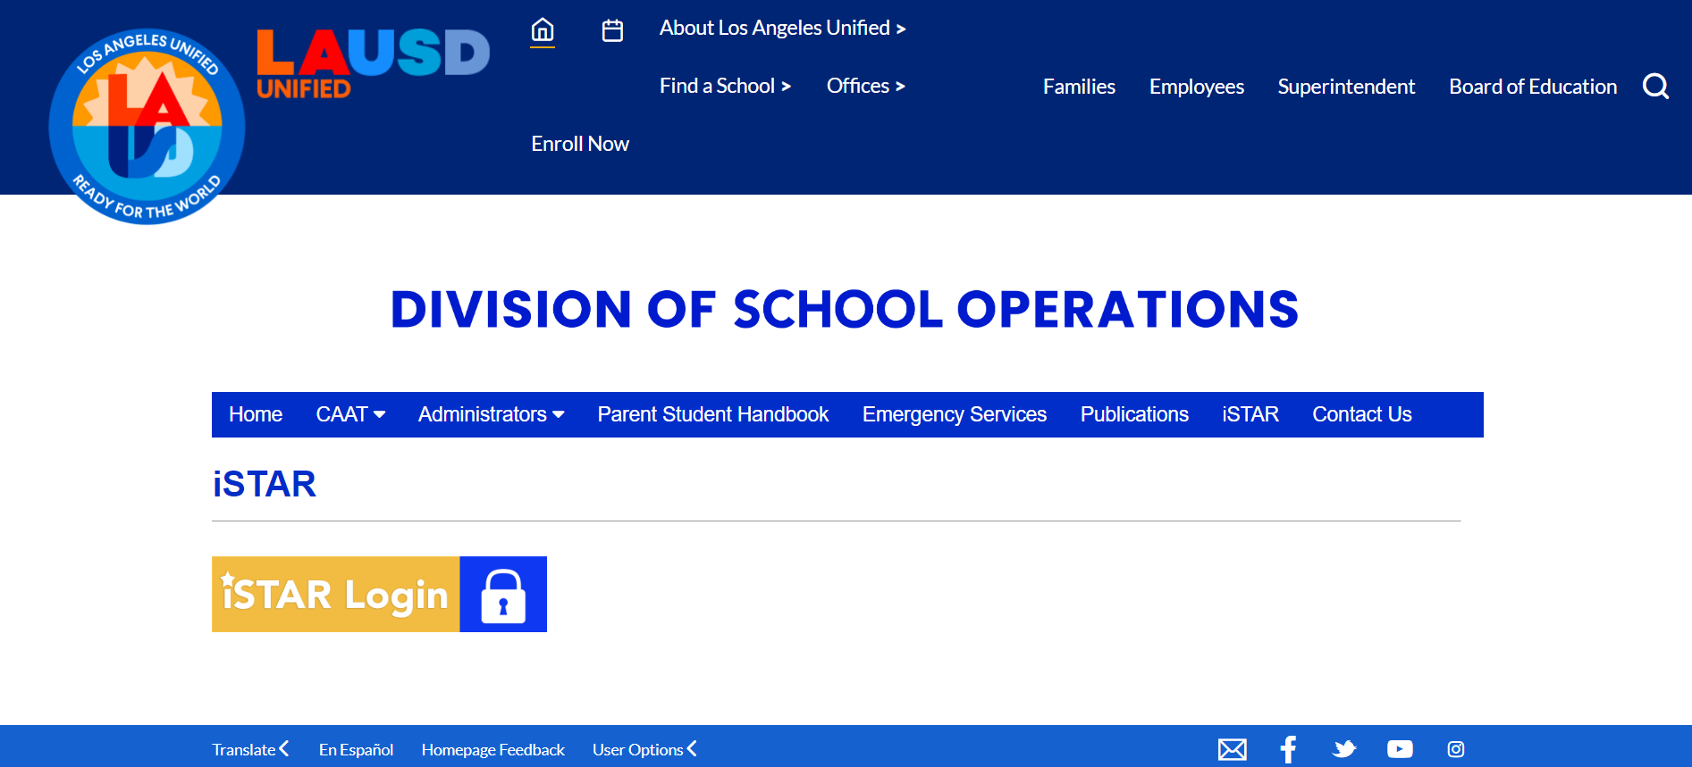
Reporting ISTAR

Slide 23
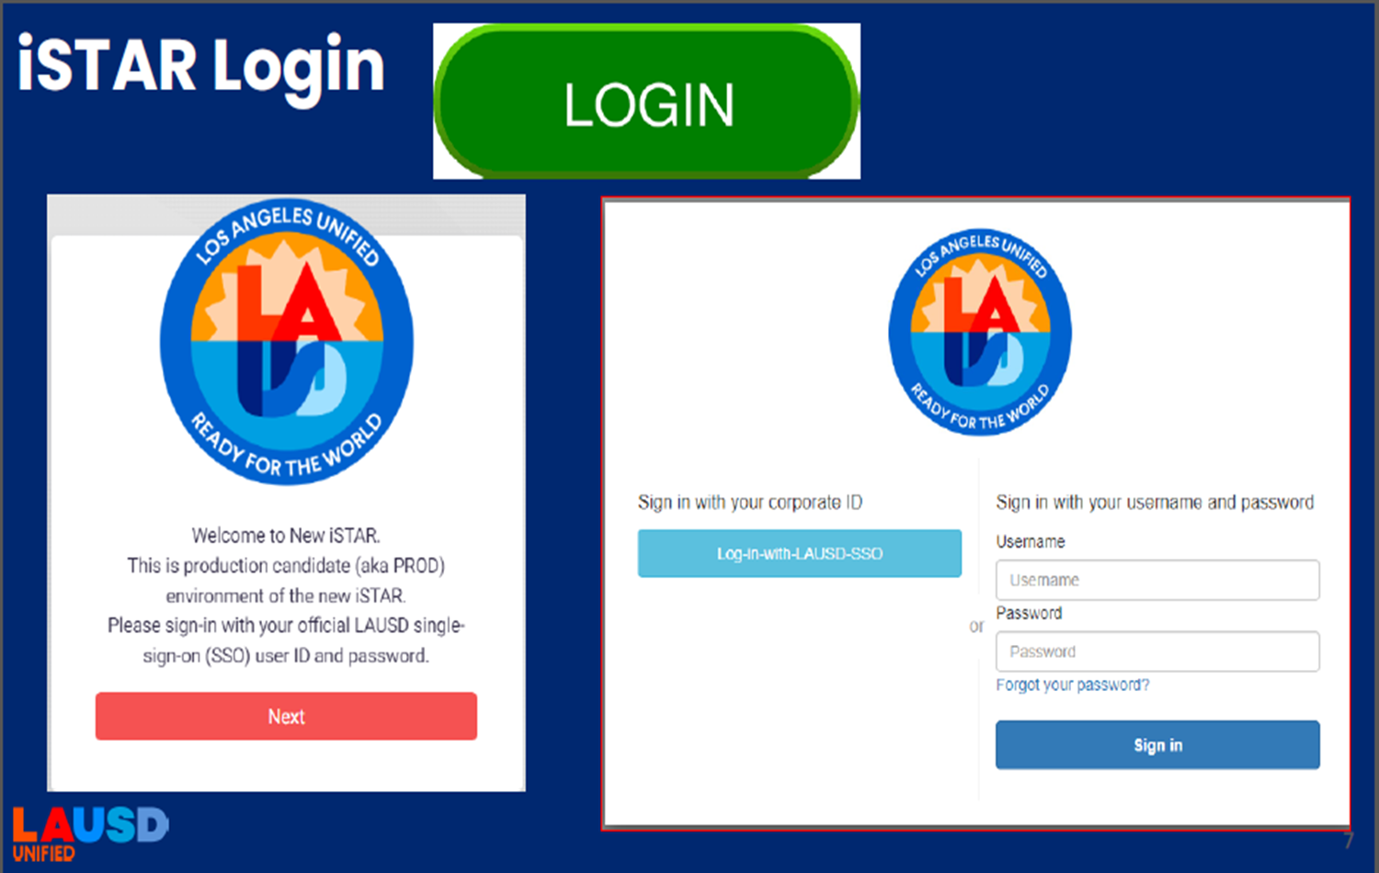
Reporting ISTAR

Slide 24
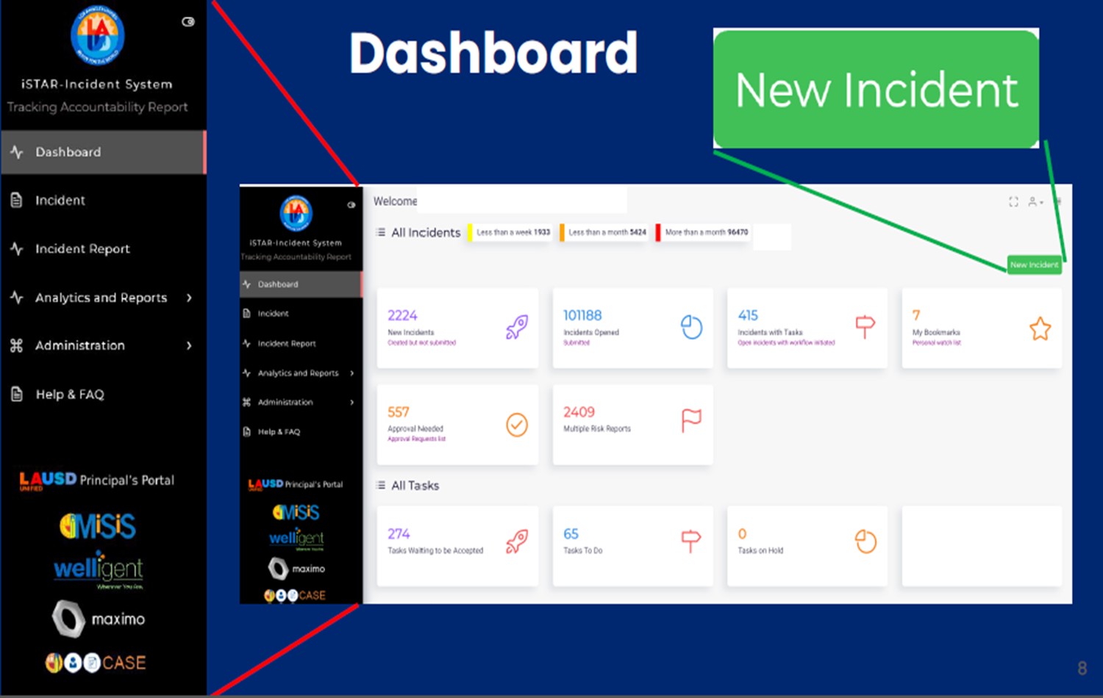
Reporting ISTAR

Slide 25
Reporting ISTAR

Slide 26
Reporting ISTAR

Slide 27
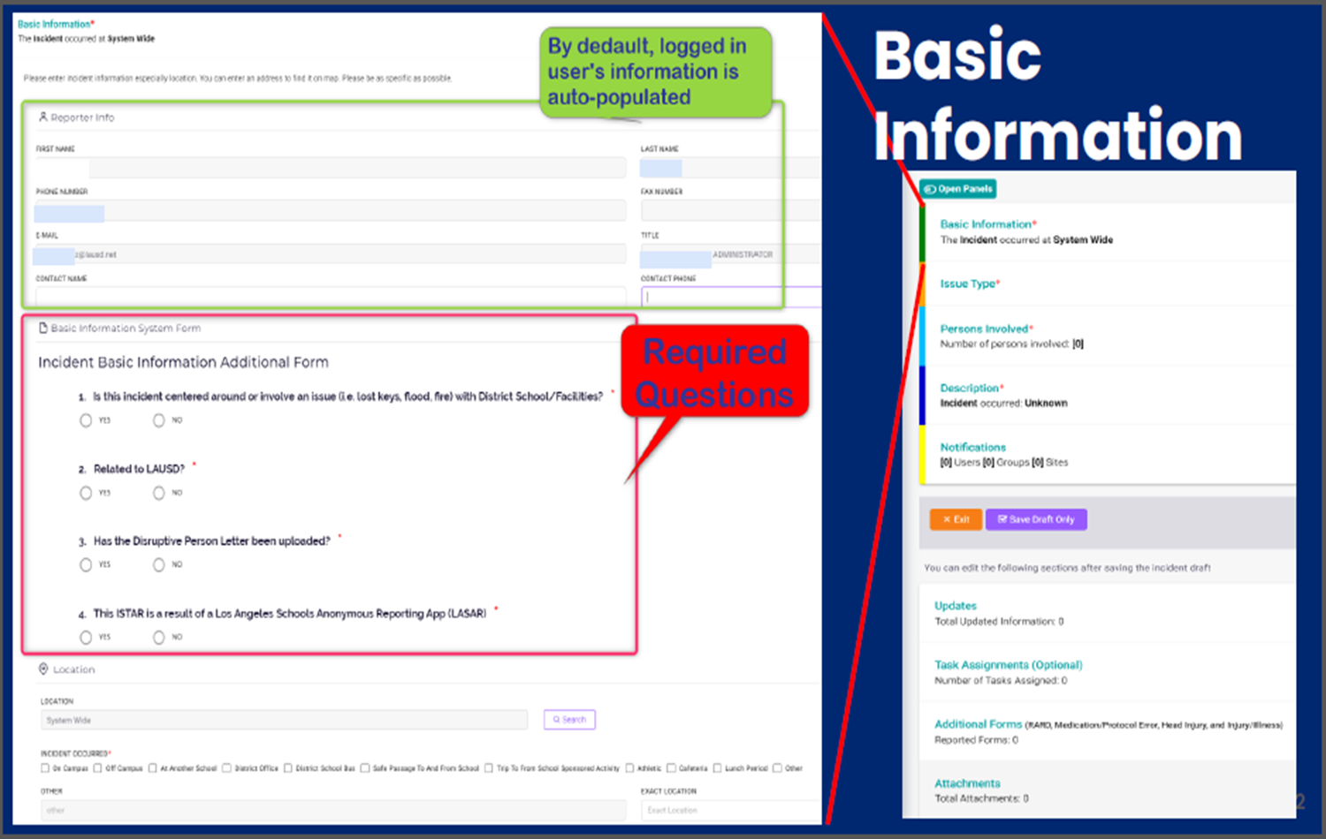
Reporting ISTAR

Slide 28
Reporting ISTAR

Slide 29
Reporting ISTAR

Slide 30
Reporting ISTAR

Slide 31
Reporting ISTAR

Slide 32
Reporting ISTAR

Slide 33
Reporting ISTAR

Slide 34
Reporting ISTAR

Slide 35
Reporting ISTAR

Slide 36
Reporting ISTAR

Slide 37
Reporting ISTAR

Slide 38
Reporting ISTAR

Slide 39
ISTAR Review
What is ISTAR?
Incident Tracking Accountability Report (Electronic Form)
What form is needed to assist in ISTAR?
Injury Report Worksheet
When does ISTAR have to be completed and submitted?
Within 24 hours of the incident.
What is an Incident?
An individual occurrence or event.
What is an Accident?
An undesirable or unfortunate happening that occurs unintentionally and usually results in harm, injury, damage, or loss; casualty; mishap.

Slide 40
Questions?

Slide 41
Reasonable Accommodation
Stay at Work Program
Fitness for Duty

Slide 42
Reasonable Accommodation
Health Clearances
Reasonable Accommodation Process
Procedures for Staying at Work with Modified Duties
Transitional Assignment plan
Fitness for Duty

Slide 43
Reasonable Accommodation
Health Clearances: When an employee returns to work after a leave of more than five working days, he/she must receive a health clearance to work around food (food safety).
This is not for finding out whether or not the employee can so the job, it’s only to ensure the employee is free from contagious disease.
This can be performed by the nurse at the school site or an authorized district doctor (see HR for the list).

Slide 44
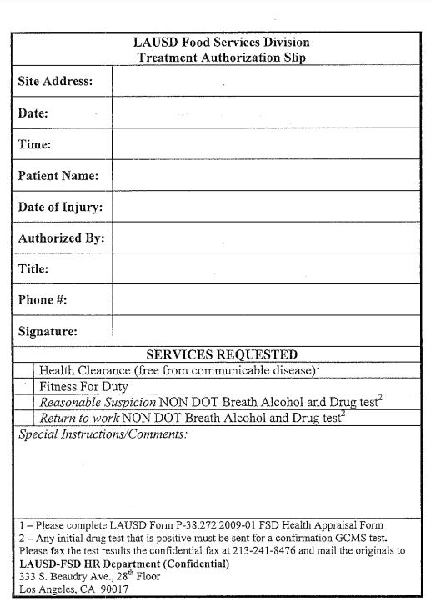
Treatment Authorization
Slip

Slide 45
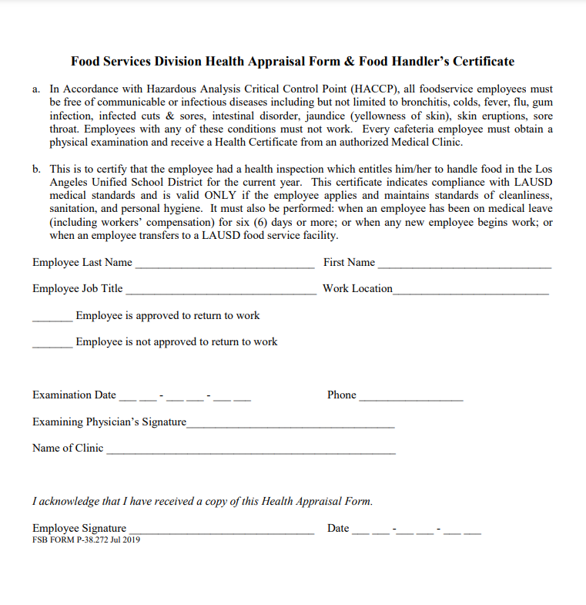
FSD Health Appraisal Form
& Food Handler’s Cert.

Slide 46
Reasonable Accommodation
Procedures for Staying at Work with Modified Duties: If employees brings a doctor’s note with work restrictions, it must be specific, e.g. no lifting more than 25 lbs. It cannot just indicate “light duty”.
Complete the Transitional Assignment Plan – 60 days maximum.
If employee complains, send back to the doctor with District’s Work Ability Form.
May update document (TAP) with new restrictions.

Slide 47
Reasonable Accommodation
Arranged when an employee cannot perform the essential functions of the job: This usually occurs when an employee has work restrictions that we cannot accommodate, e.g. no standing, no use of the left hand, must take a break every 20 minutes.
The work restrictions can be told to you by the employee or given to you by a doctor’s note.
We do not accommodate for “perceived” disabilities.

Slide 48
Reasonable Accommodation Process
Involves:
Set up time for meeting.
Evaluate job description.
Engage in an “Interactive Process” (IP) meeting.
Employee must bring medical documentation to support need for assistance.
Write down what we can or cannot accommodate.
Information must be kept confidential.
Must evaluate “essential job functions” and if accommodations will suffice for the employee to perform the job.
Reasonable Accommodation is completed in the Attachment A (Record of Interactive Process).
If it’s determined that the employer cannot accommodate, the employee should be referred to the “Reasonable Accommodation” committee.
Employee must complete Attachment B (Reasonable Accommodation Application).

Slide 49
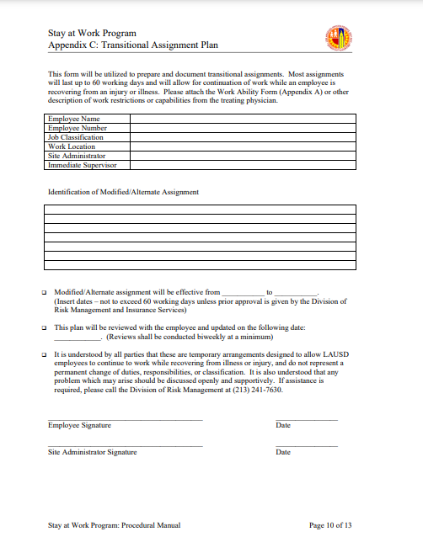
Transitional Work Assignment

Slide 50
Reasonable Accommodation Process
Transitional Work Assignment:
Write down what employee either can do or can’t do.
Enter dates for the modified duty.
Can be for less working hours.
Timeframe is only until next doctor visit.
Must update TAP when you get new doctor’s note.
Keep confidential in file.

Slide 51
Practice:
Transitional Assignment Plan 4-hour FSW
Can you accommodate the following restrictions?
Work Restrictions: No lifting over 25 lbs., must have a 10-minute break every four hours and no going into the freezer.
Yes, because the employee takes a break every 2 hours, and normally only works in the freezer maybe just to pull items out, less than five minutes, or put a delivery away. Thus, temporarily, freezer work may not be required.
Work Restrictions: Sitting work only.
No, because we don’t have a chair for them to sit on, and they have to walk around the cafeteria.

Slide 52
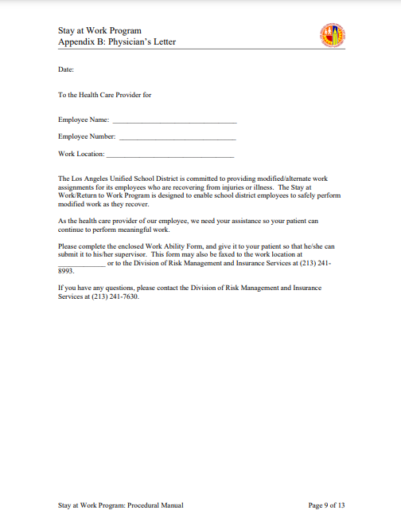
Letter to Physician

Slide 53
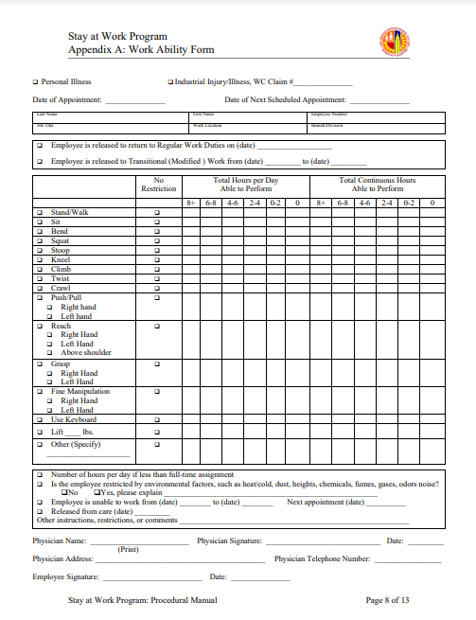
Work Ability Form

Slide 54
Return to Work Clearances:
Fitness for Duty & Health
Fitness for Duty Definition: When an employee is unable to perform assigned tasks, and the employer deems it’s a health and safety issue.
Fitness for Duty Issues (Examples):
Physical State – employee unable to grasp verbal commands, appears under the influence, or states he/she cannot perform job functions.
Emotional State – employee yelling, punching themselves, hitting head on counter, ect.
Personal Hygiene – employee urinating/defecating on self, offensive odor, fails to bathe, ect.

Slide 55
Fitness for Duty
Process
Involves:
The employee possibly being removed from the worksite.
You must first contact Food Services Division HR Rep. They will send letter stating the employee is being placed off due to his/her health/safety or hygiene.
Employee is given a specific amount of time to obtain a doctor’s note for time off work and return to work.
The employee may be required to sign a release to give medical information to the District’s Doctor or Medical Clinic.
The HR Representative will assist you through the process.
The doctor must complete the “Doctor’s Work Ability Form”.
When necessary, the employee must complete the release of information form to be disclosed to Dr. Malhotra.
Once the employee is released to work, he/she may be required to see Dr. Malhotra before returning to work.

Slide 56
Conclusion
You should know the following:
The Health Clearance Process
The Reasonable Accommodation Process
Procedures for Staying at Work with Modified Duties
Transitional Assignment Plan
Fitness for Duty

